Slide 1
AVL TREES

Slide 2
Height-balanced Binary search tree (AVL Tree)
The disadvantage of a skewed binary search tree is that the worst case time complexity of a search is O(n). In order to overcome this disadvantage, it is necessray to maintain the binary search tree to be of balanced height. Two Russian mathematicians , G.M. Adel and E.M. Landis gave a technique to balance the height of a binary tree and the resulting tree is called AVL tree.
Definition: An empty binary tree is an AVL tree and a BSt is called AVL tree if the balance factor(BF) of a each node can be either -1, 0 or 1 . To calculate BF
Height of left subtree of node – height of right subtree of node.
Every AVL tree is a binary search tree

Slide 3
An AVL tree (Adelson-Velskii and Landis' tree, named after the inventors) is a self-balancing binary search tree.
In an AVL tree, the heights of the two child subtrees of any node differ by at most one; if at any time they differ by more than one, rebalancing is done to restore this property.
An AVL tree is a BST in which each node has a balance factor (B_{f}) of +1,0 or -1.

Slide 4
The balance factor of a node is the difference of the height of the left subtree (h_{L)}and height of the right subtree(h_{R})
B_{f}=h_{L}-h_{R)}
if a node has a balance factor of +1 then its subtree is said to be left heavy since the height of left subtree is greater than then right subtree.
if a node has a balance factor of -1 then its subtree is said to be right heavy since the height of right subtree is greater than then left subtree.
If a node has balance factor of 0 then its subtree is said to be balanced.

Slide 5
AVL ROTATION
Whenever a node is inserted or deleted from an AVL tree then the resultant tree may become unbalanced.So we must rebalance the tree by performing an operation known as AVL rotation.
A rotation rebalances a part of AVL tree by rearranging node in such a way that BST property is preserved.
After performing rotation ,the balance factor of each node in the rotated subtree becomes either +1,0,-1

Slide 6
AVL Rotations can be classified into following four categories.
LL (Left-Left) Rotation
LR (Left-Right) Rotation
RR (Right-Right) Rotation
RL (right-Left) Rotation
Among these LL and RR rotations are also known as single rotation and LR and RL rotations are known as double rotation.

Slide 7
In order to understand when to apply each rotation ,let us consider a node N that is inserted at its correct position in the AVL tree and let P present a pivot node which is the nearest ancestor node whose balance factor has changed to other than +1,0,-1 on inserting the node N.

Slide 8
LL ROTATION
LL rotation is performed when the node N is inserted in the left subtree of the left child of the pivot node P.
In order to rebalance the BST using LL rotation ,we perform following steps:
1.the right subtree (X_{R}) of the left child (X) of the pivot node(P) becomes the left subtree of P
2.P becomes right child of node X.
3.left sub tree (X_{L}) of the node X remains unchanged.

Slide 9
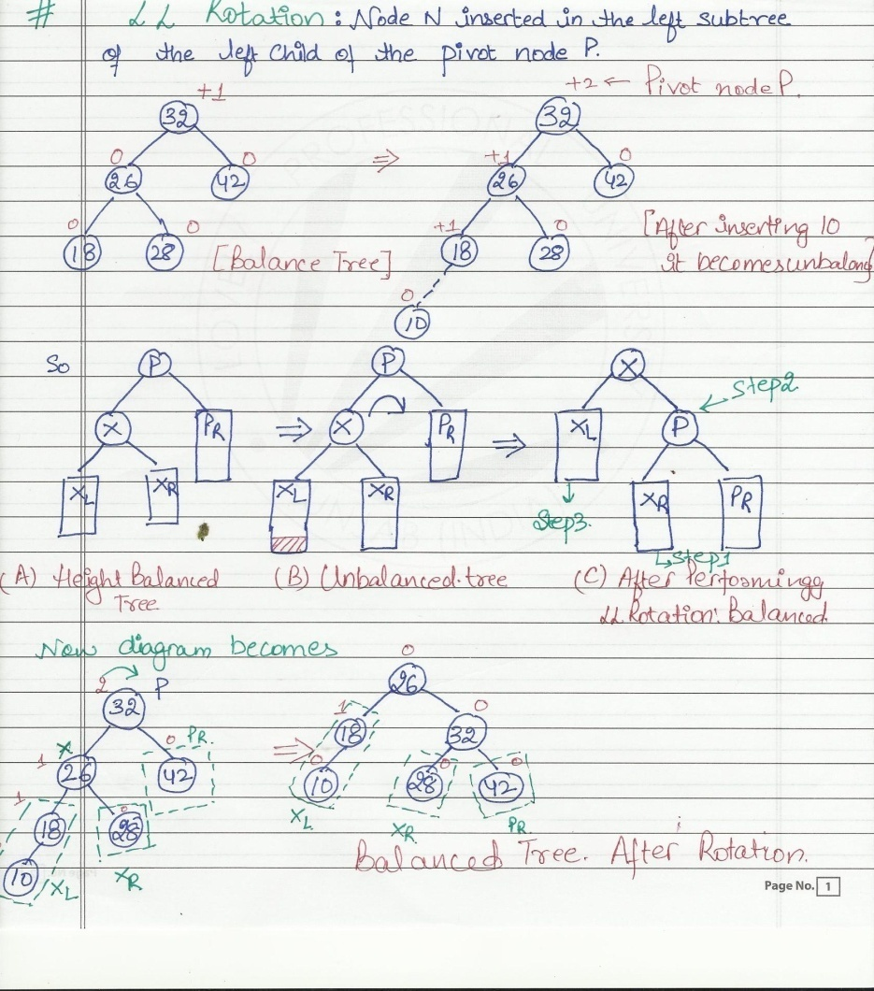

Slide 10
RR ROTATIONS
RR rotation is performed when a node N is inserted in the right subtree of the right child of the pivot node P. In order to rebalance this BST using RR rotation, we perform the following steps:
1. The left subtree (Y_{L} ) of the right child (Y) of the pivot node (P) becomes the right subtree of P.
2. P becomes the left child of node Y.
3. Right subtree (Y_{R} ) of node Y remains unchanged.
After RR rotation , the AVL tree has the same height s it had before the insertion of node.

Slide 11
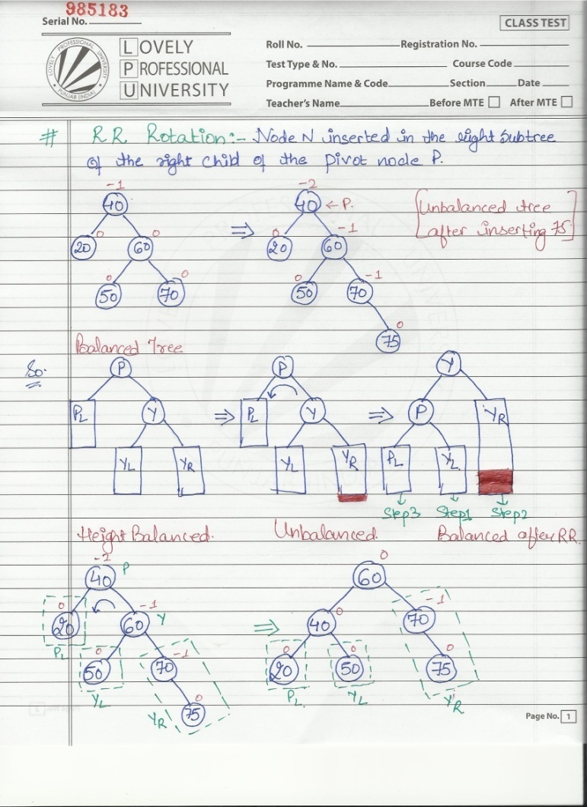

Slide 12
LR ROTATION
LR Rotation is performed when node N is inserted in the right subtree of the left child of the pivot node P.
In order to explain LR rotation,let us assume node X be the left child of node P,and node Z be the right child of node X.The following steps are performed in the LR rotation.

Slide 13
  ROTATION 1:
  The left subtree of node Z (Z_{L}) becomes the right subtree of node X.
  2.The left child (node X) of the pivot node P becomes the left child of node Z
  ROTATION 2:
  3.The right subtree of node Z (Z_{R}) becomes the left subtree of node P.
  4.P becomes the right child of node Z.

Slide 14
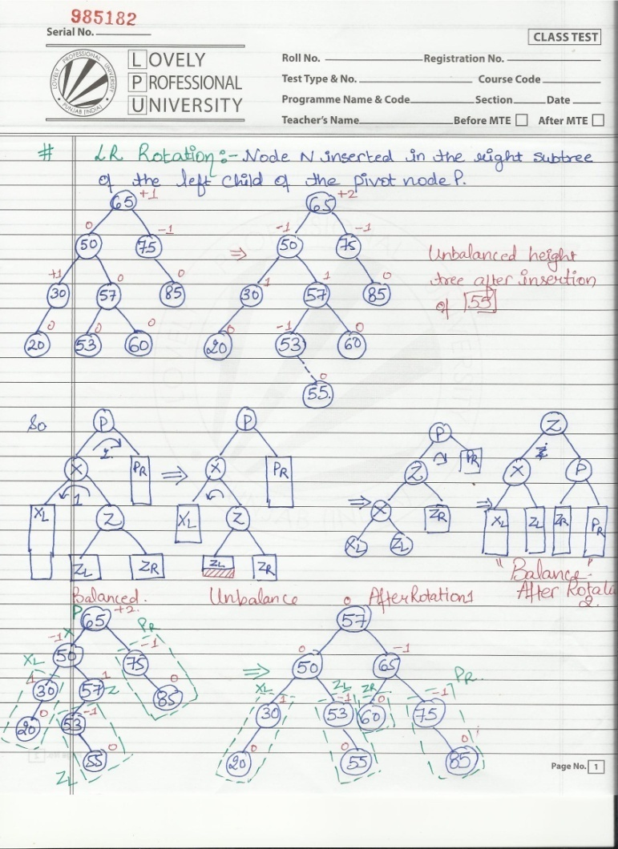

Slide 15
RL ROTATION
RL( Right-Left) rotation is just mirror image of LR rotation. It is performed when a node N is inserted in the left subtree of the right child of the pivot node P. Like LR rotation , it is also a double rotation process.
Let us assume node Y be the right child of node P and node Z be the left child of node Y. The following steps are performed in RL rotation:

Slide 16
Rotation 1
1. The right subtree of node Z (Z_{R} ) becomes the left subtree of node Y.
2. The right child (node Y) of the pivot node P becomes the right child of node Z.
Rotation 2
3. The left subtree of node Z( Z_{L} ) becomes the right subtree of node P.
4. P becomes the left child of node Z.

Slide 17
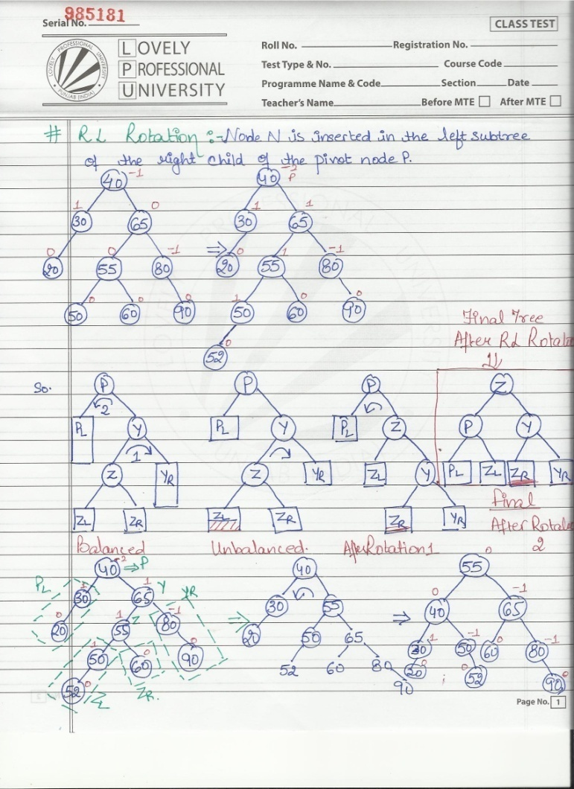

Slide 18
Deletion in AVL
Delete a node x as in ordinary BST (Note that x is either a leaf or x has exactly one child.).
Check and restore the AVL tree property.
Trace from path of deleted node towards the root, and check if the AVL tree property is violated.
Similar to an insertion operation, there are four cases to restore the AVL tree property.

Slide 19
Deletion
The only difference from insertion is that after we perform a rotation at x, we may have to perform a rotation at some ancestors of x. → It may involve several rotations.
Therefore, we must continue to trace the path until we reach the root.
The time complexity to delete a node is dependent on the height of the tree, which is also O(log(n)).
Rotations of deletion :
1) L rotations
  L0 apply RR
  L1 apply RL
  L-1 apply RR
2) R rotations
  R0 apply LL
  R1 apply LL
  R-1 apply LR
AVL trees

Slide 20
Deletion from AVL Tree
Basically follows deletion strategy of binary search tree
  But may cause violation of AVL tree property
Restore the destroyed balance condition if needed
20
20
10
35
15
35
5
15
25
40
10
18
25
40
18
30
38
45
30
38
45
50
50
Delete 5, Node 10 is unbalanced
Single Rotation

Slide 21
Cont’d
20
35
15
35
20
40
10
18
25
40
15
25
38
45
30
38
45
10
18
30
50
Continue to check parents
Oops!! Node 20 is unbalanced!!
50
Single Rotation
For deletion, after rotation, we need to continue tracing upward to see if AVL-tree property is violated at other node.
Different rotations are classified in R0, R1, R-1, L0, L1 And L-1

Slide 22
Different rotations
An element can be deleted from AVL tree which may change the BF of a node such that it results in unbalanced tree.
Some rotations will be applied on AVL tree to balance it.
R rotation is applied if the deleted node is in the right subtree of node A (A is the node with balance factor other than 0, 1 and -1).
L rotation is applied if the deleted node is in the left subtree of node A.
Notes:
목차
자바의 생성배경
자바를 사용하는 이유
과거, 현재, 미래의 자바
자바의 발전과정
버전별 JDK에 대한 설명
자바와 C++의 차이점
자바의 성능
자바 관련 산업(?)의 경향

Slide 23
Different rotations cont…
Suppose we have deleted node X from the tree.
A is the closest ancestor node on the path from X to the root node, with a balance factor -2 or +2.
B is the desendent of node A on the opposite subtree of deleted node i.e. if the deleted node is on left side the B is the desendent on the right subtree of A or the root of right subtree of A.
Notes:
목차
자바의 생성배경
자바를 사용하는 이유
과거, 현재, 미래의 자바
자바의 발전과정
버전별 JDK에 대한 설명
자바와 C++의 차이점
자바의 성능
자바 관련 산업(?)의 경향

Slide 24
R Rotation
R Rotation is applied when the deleted node is in the right subtree of node A.
There are three different types of rotations based on the balanced factor of node B.
R0 Rotation: When the balance Factor of node B is 0.
  Apply LL Rotation on node A.
R1 Rotation: When the balance Factor of node B is +1.
  Apply LL Rotation on node A.
R-1 Rotation: When the balance Factor of node B is -1.
  Apply LR Rotation(RR rotation on B and LL rotation on node A).
Notes:
목차
자바의 생성배경
자바를 사용하는 이유
과거, 현재, 미래의 자바
자바의 발전과정
버전별 JDK에 대한 설명
자바와 C++의 차이점
자바의 성능
자바 관련 산업(?)의 경향

Slide 25
L Rotation
L Rotation is applied when the deleted node is in the left subtree of node A.
There are three different types of rotations based on the balanced factor of node B.
L0 Rotation: When the balance Factor of node B is 0.
  Apply RR Rotation on node A.
L-1 Rotation: When the balance Factor of node B is -1.
  Apply RR Rotation on node A.
L1 Rotation: When the balance Factor of node B is +1.
  Apply RL Rotation(LL rotation on B and RR rotation on node A).
Notes:
목차
자바의 생성배경
자바를 사용하는 이유
과거, 현재, 미래의 자바
자바의 발전과정
버전별 JDK에 대한 설명
자바와 C++의 차이점
자바의 성능
자바 관련 산업(?)의 경향

Slide 26
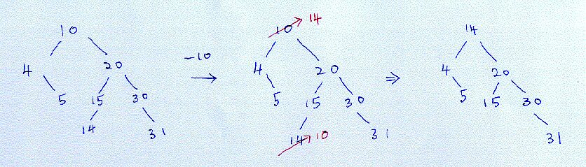
Deletion : no rotation
No need to rotate.
AVL trees

Slide 27
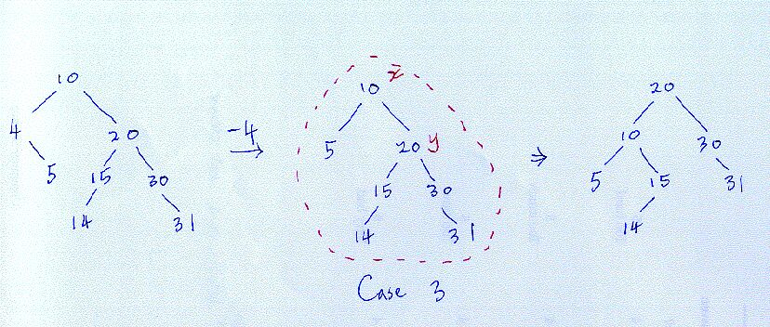
Deletion : one rotation
Case 1 : Single rotate with right child.
AVL trees

Slide 28
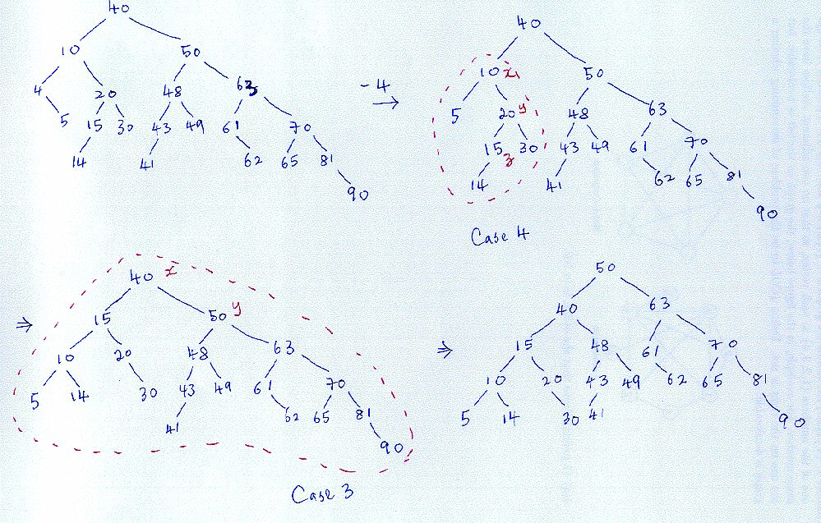
Deletion : several rotations
Case 2 : Double rotate with right child.
Case 3 : Single rotate with right child.
AVL trees

